Slide 1


Change Ideas
A quick guide by Gerke Lange

Slide 2

Change Ideas
What are change Ideas? What is the purpose of change ideas?
When – change ideas - part of the improvement process
How - tools and approaches to come up with change ideas
Now – tips for change ideas in the virtual world
Notes:
I am going to cover ….

Slide 3
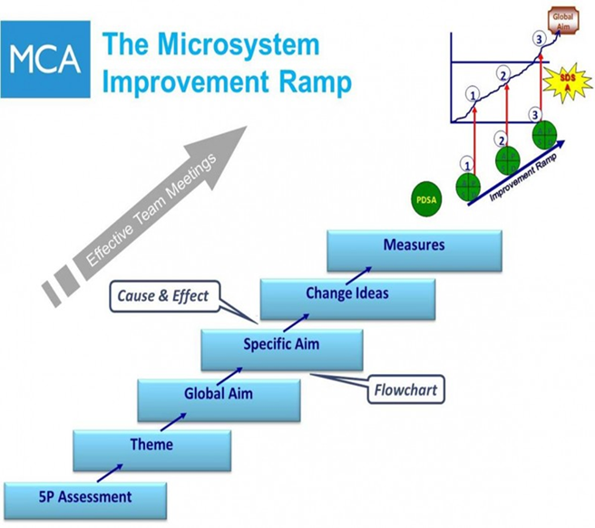

Change Ideas Ideas for improvement work

Slide 4
Change Ideas
Test the process we hope to improve
Redesign the process we hope to improve
Measure – data = evidence for change idea is an improvement
Working it out together – NOT settling on the first idea/
NOT starting with the solution
Remember to be specific and clear!

Slide 5
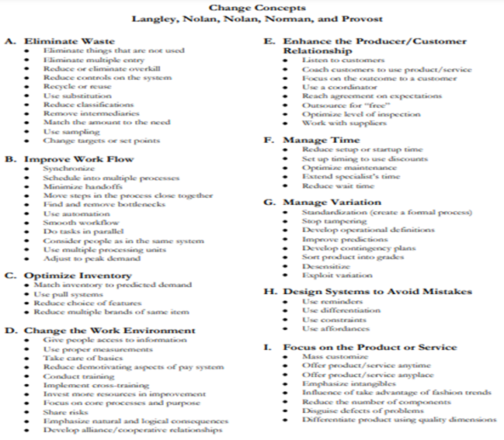

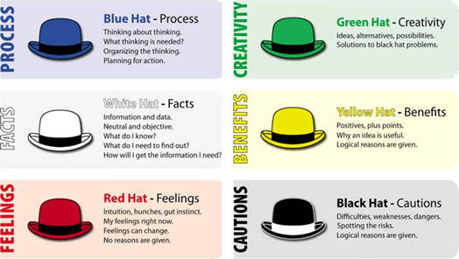
Change Ideas
Nolan’s Change Concepts
Best practice & Benchmarking
De Bono’s 6 Hats
Notes:
Number of different tools or approaches to coming up with change ideas, which enable everyone to get involved, have a say and put their ideas forward

Slide 6
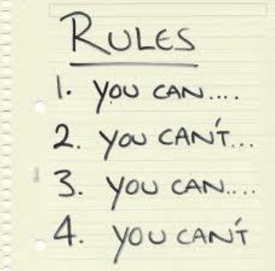
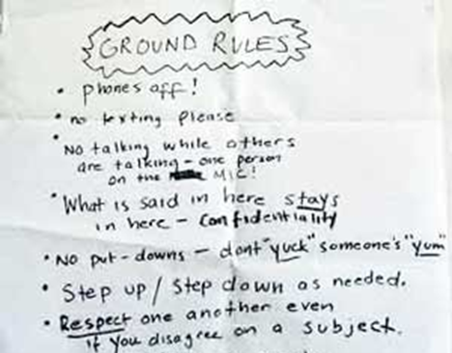
Change Ideas
Brainstorming
Ground rules:
•No discussion during quiet phase
•No criticism of ideas… not even a groan or a grimace!
•Build on each others ideas
•Write ALL ideas on flipchart for all to see
Notes:
No idea is too big, too small or out of the question
Do not judge or criticise others ideas
Listen to others’ ideas and build on them

Slide 7
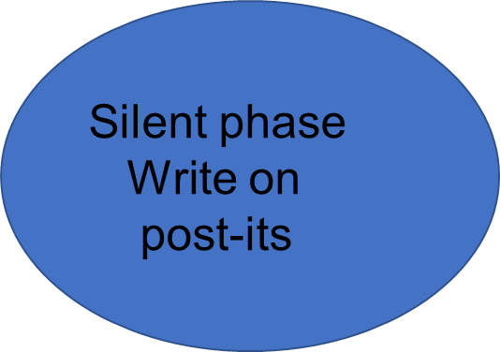

Change Ideas
Brainstorming Process
Read out ideas
And
Stick up
Shout out
And
Build on ideas
Group
And
Multi-vote

Slide 8
Change Ideas
Multi Voting
1.Narrow the list
2.Decide some criteria
3.Vote as a team
Ideas that can be started fast
The change is reasonably low cost
The effort is small compared to the impact
The idea can be tested without getting ‘permission’ from others
Notes:
3.Review all the ideas and group similar ones/remove duplications to narrow the list down
4.Vote on all the ideas to choose what to do next based on some agreed criteria
5.Count the votes and then plan the test of change accordingly
Medical Day Care example;
1.Pharmacy technician
2.Improve communication about waiting times with service users on their arrival

Slide 9
Change Ideas
Examples of Change Ideas
Support staff arrive 1 hour before clinic opens
Standardise rooming vs guidelines
Serial scan sticker in front of notes and on patient’s hand held notes
Manage Time
Improve Work Environment
Manage Variation

Slide 10
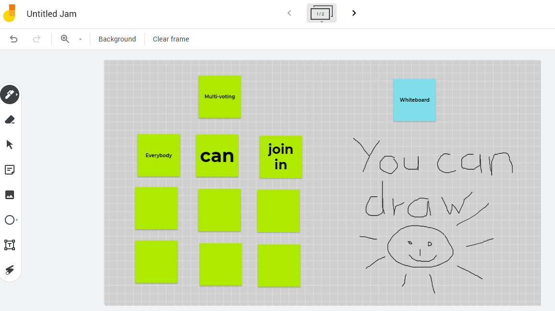
Change Ideas in virtual times
Jamboard
Create a post-its board virtually
Draw ideas on the white board
Multi Voting
https://jamboard.google.com

Slide 11
Change Ideas
Thank you for listening!
If you like to learn more about Quality Improvement tools &
how they can help your team to make improvements do get in touch.
Speak to or e-mail a QI Team member
QITeam@shsc.nhs.uk

