Slide 1

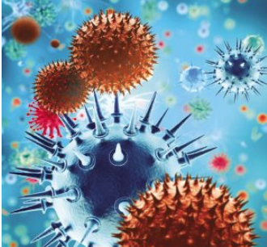

Infection, Prevention and Control

Slide 2
Learning Outcomes
Know how individuals can contribute to infection prevention and control
Have knowledge of and demonstrate the standard infection prevention and control precautions relevant to your role. This may include:
Hand Hygiene
Personal Protective Equipment (PPE)
Management of Blood and Body Fluid Spillage
Management of Occupational Exposure (including sharps)
Management of the Environment
Management of Care Equipment.

Slide 3
Covid-19 Outbreak
Please note the information in this presentation gives guidance on standard procedures.
Due to the Covid-19 outbreak, guidance is changing continually therefore please read the Covid-19 Daily Briefing and the Covid-19 Information Hub for up to date Infection Control guidance.

Slide 4
Introduction
Infection Prevention and Control Is expected to be at the heart of good management and clinical practice, to ensure effective protection of the public’s health and minimise the risk of healthcare associated infections (HCAIs). Effective prevention and control must be embedded into everyday practice and applied consistently by everyone. All staff, both clinical and non-clinical, must be able to demonstrate good infection control and hygiene practice.

Slide 5
Patients and their relatives rightfully expect care to be delivered in an environment where risks are proactively reduced and the control of healthcare associated infection is recognised in all areas of the Trust to an important aspect in the provision of care. This can only happen if all staff accept responsibility for their role in ensuring good infection control practice is adhered to at all times.

Slide 6
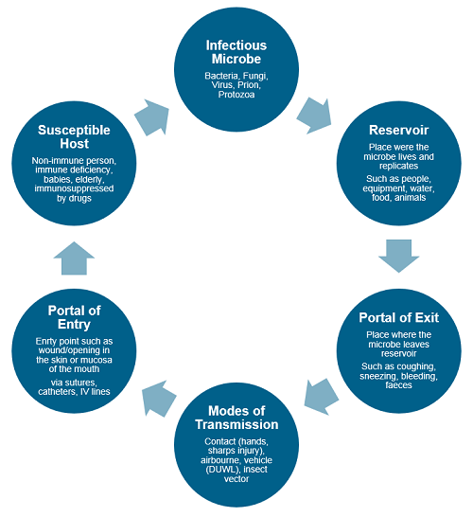
The Chain of Infection
To prevent the spread of infection, break any one of the links in the chain.

Slide 7
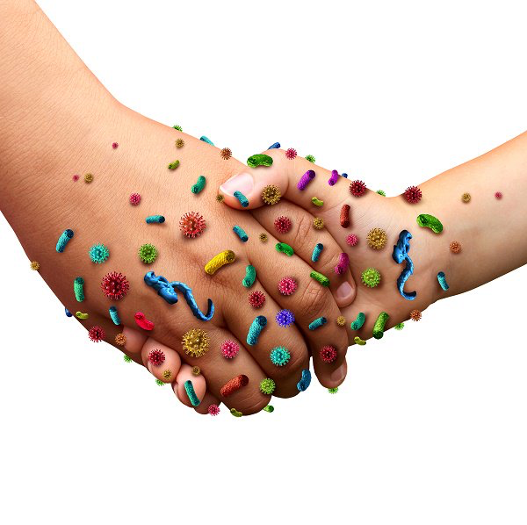
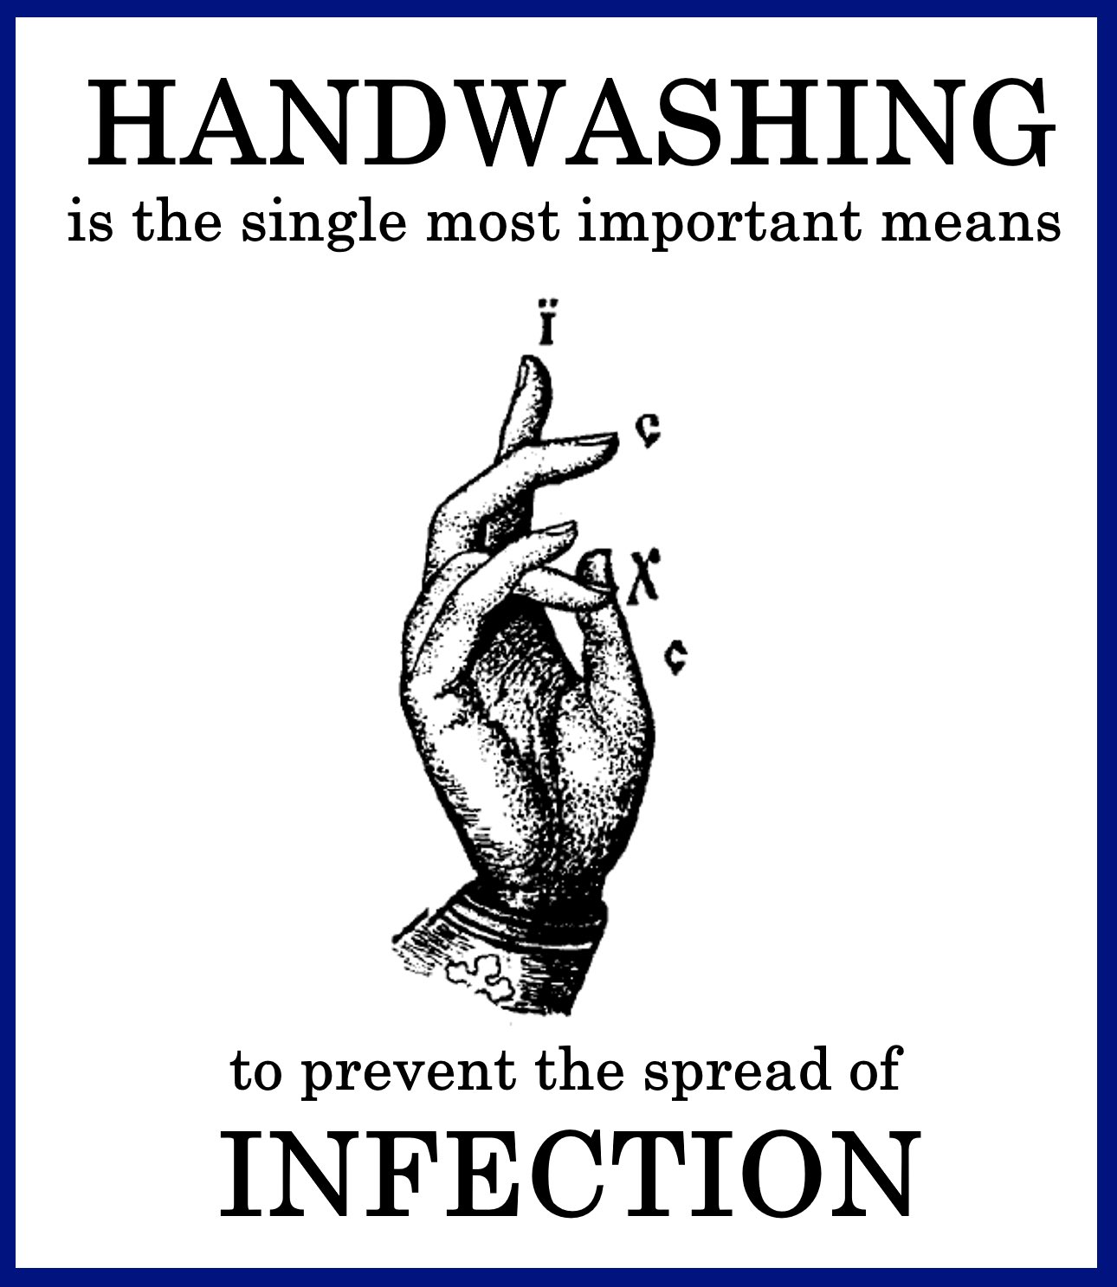
Hand Hygiene
5 Moments for Hand Hygiene
Before patient contact
Before aseptic task
After body fluid exposure risk
After patient contact
After contact with patient zone

Slide 8
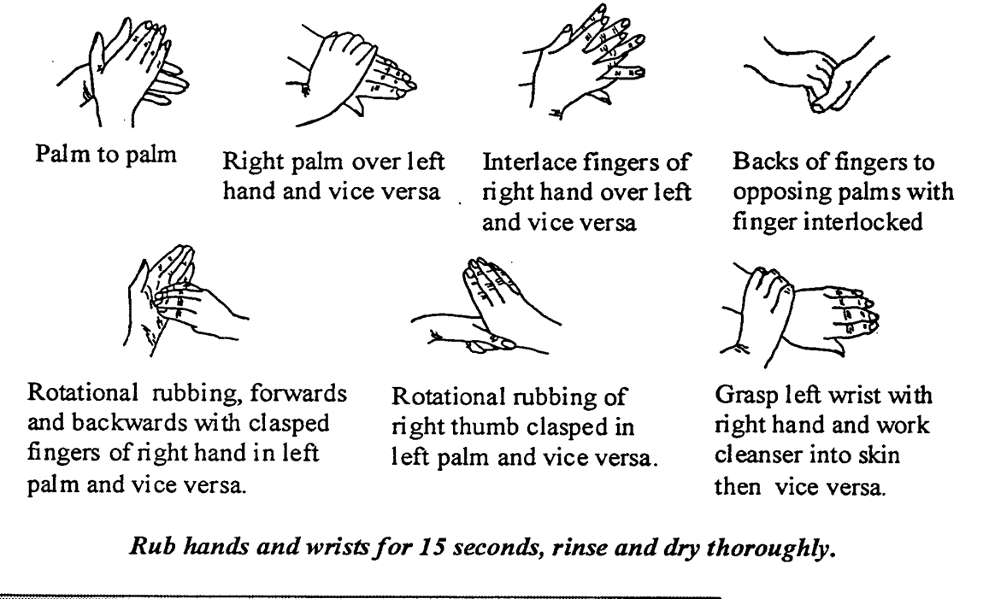
Required Method
PLEASE NOTE
Currently staff giving direct care are required to include washing arms up to the elbows.

Slide 9
Bare Below the Elbows….
Hand hygiene is the most important method of preventing the spread of infection.
All staff will need to comply with "BBTE" principles when providing direct clinical care to patients or touching the immediate patient environment
Any staff who do not work in a clinical environment, but may need to enter the patient environment as part of their role, will need to have the ability to be Bare Below the Elbow and comply on these occasions.

Slide 10
Personal Protective Equipment
May include the following (task dependent):
  Gloves
  Aprons
  Masks
  Eye / Face Protection
  Oversuits
  Single use only
Remember to check the latest guidance on the Covid-19 Daily Brief
Notes:
GLOVE USE – does not replace a good standard of hygiene. Consider your reasons for glove use. Overuse can cause allergies and adverse reactions. Intact skin is a valuable defence mechanism. Should be used for body fluid exposure if contamination of hands is likely, for aseptic procedures – catheter care, dressings, etc. If service user has MRSA, C-diff, etc. Must be changed between service users. Hands to be cleaned before and after glove use.
Aprons – must be worn if it is likely that body fluids may soil clothing and for close service user contact including bed making. Must be changed between each service user contact.
MASKS – FFP3 type suitable for use in Pandemic Flu situation. Must be fitted correctly.
REGULAR MASKS AND EYE PROTECTION to be worn if risk of body fluids splashing into eyes and face.

Slide 11

Decontamination
Follow cleaning schedules – these must be displayed and go into
good level of detail
Clean equipment regularly with appropriate products
i.e. beds, baths, hoists, commodes, bins, mattresses, computers, phones,
keyboards, reusable patient equipment
Nobody is too posh to wash!
Clean after use – stethoscopes etc

Slide 12
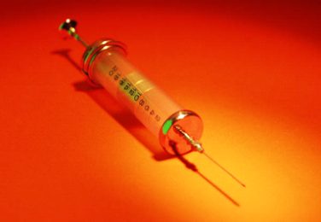
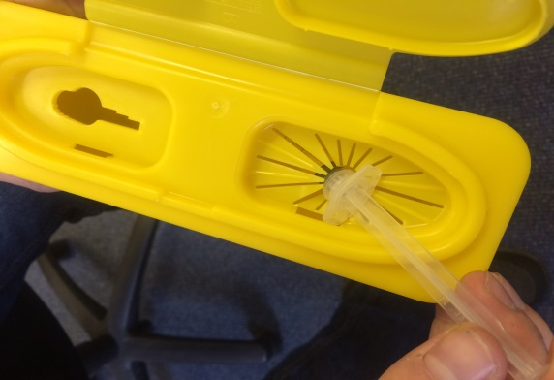
Management of Sharps
Dispose of sharps immediately in the correct receptacle
Safe assembly and use
Report needlestick injuries immediately
First aid – irrigate, bleed, cover
Risk assess situation – Inform Occupational Health
0330 – 660 - 0365
Complete an incident form
Report near-misses – it’s how we learn
Notes:
SHARPS – Any sharp object that could break the skin – needles, scalpels, etc. All sharps must be discarded into an authorised kite marked bin of appropriate size at the point of care. Dispose directly into the bin. Put in gently sharp end first. Do not put sharps into plastic bags. Once 2/3rds full remove the bin. Close securely and sign the label. Do not seal with tape. Do not attempt to retrieve items out of sharps bins. Do not empty out the contents of sharps bins. Do not place sharps bins inside clinical waste bags. All incidents regarding Sharps must be reported to the Manager on duty and an incident form completed.

Slide 13
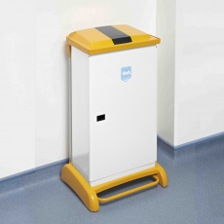
Waste
Ensure waste segregated appropriately
Household waste into black bags
Infectious waste (dressings, blood etc) into orange bags
Incontinence and sanitary waste into Tiger striped bags
Only fill waste bags to 3/4s full and ensure they are secured
Keep bins clean
Notes:
Clinical Waste – now known as Healthcare Waste. Ensure it is sorted into the relevant bags. Clinical waste into yellow, household waste into black, incontinence waste into tiger striped. Avoid body contact with bags of healthcare waste. Aprons should be worn. All waste containers should be stored safely and be inaccessible to service users, children and members of the public. Bags should only be 2/3rds full and secured. Tetanus and Hepatitis B Vaccinations are available via Occ Health.

Slide 14
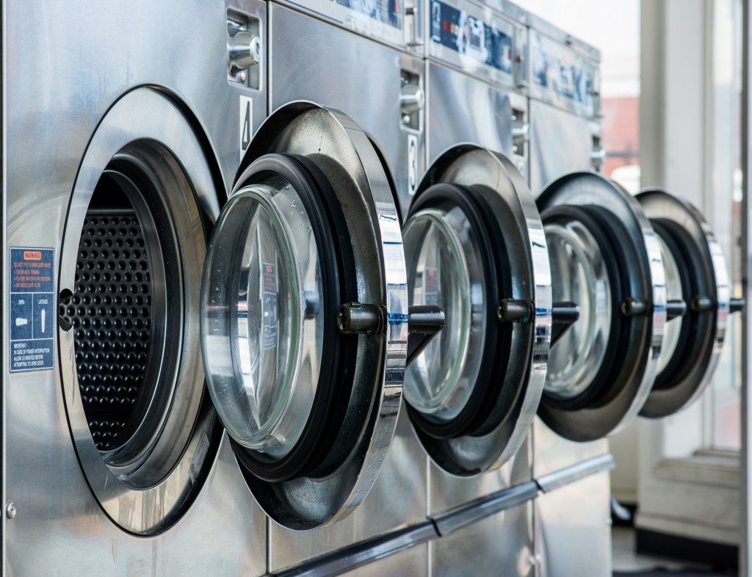
Laundry
Sort soiled linen streams
Dirty – Clean streams
Use alginet bags
Storage of clean laundry
Remember PPE
Laundering of uniforms/work gear – wash at 60º
No unofficial restrooms

Slide 15
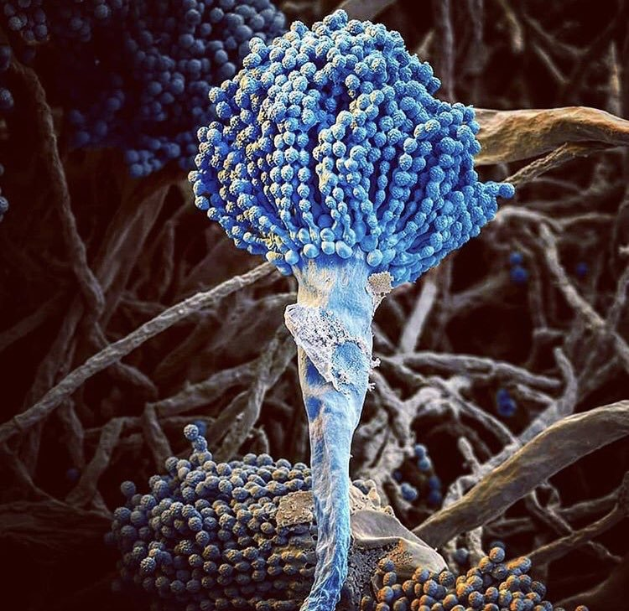
If you have any questions please contact:
katie.grayson@shsc.nhs.uk
jill.perlstrom-wright@shsc.nhs.uk
Thankyou

